Slide 1
Module 2: Writing a Proposal Report
Introduction to Academic English
for
Business and Economics Students
Week 7, Lesson 2
(clickbd.com)

Slide 2
In this lesson you will:
Identify the different sections of the Proposal Report
Research information using a source pack
Plan and write a Proposal Report
Use different styles of survey questions

Slide 3
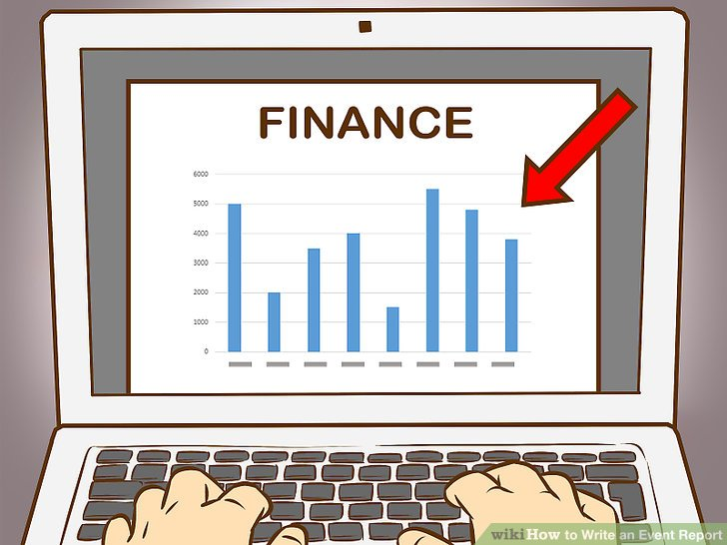
Proposal Report
A proposal report:
gives detailed and accurate information about a problem to a manager
gives information about how research was carried out
explains what the survey discovered
uses evidence to make proposals (recommendations) to a manager

Slide 4
Paragraph 1 - Introduction
In the introduction you need to:
say who you are (professionally)
give the aim of the report
write a short background to the problem
give the focus question
give the sequence of the report
Treklense.com

Slide 5
Paragraph 1 - Introduction (Cont.)
For example:
We are a team of researchers from Healthwise PLC.
We were
asked to carry out research to find out how the company can increase its sales of Gleam toothpaste.
Our toothpaste is very
high quality and uses natural ingredients. However, our sales
numbers are not very high.
How can we persuade customers
to buy our product and that it is worth the extra cost?
In addition
to the Introduction, this report will contain:
Methodology for Problem Resolution to explain how the team carried out the research
Results and Solutions, parts 1 and 2 to explain our recommendations
Conclusions to summarise our findings

Slide 6
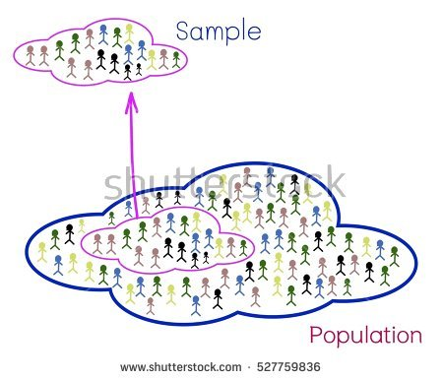
Paragraph 2 – Methodology for Problem Resolution
Explain what the team did and why. You need to describe:
survey instrument – information about the questions
what information you expect to find out before doing the survey
sample group – how many, who, why etc.
where, when you did the survey and why
any problems the team had

Slide 7
Paragraph 3 – Results and Solutions
Look at all the graphs from the survey
Choose the 4 graphs that will help answer the focus question
Paragraph 3: Describe the data on 2 graphs. Talk about
highs, lows, trends etc.
make recommendation(s) to 1 or more of the following:
Advertising and Marketing Department
Product Development Department
Research Department

Slide 8
Paragraph 4 – Results and Solutions
Go through the same procedure as Paragraph 3
Paragraph 4: Describe the data on 2 graphs. Talk about
highs, lows, trends etc.
make recommendation(s) to 1 or more of the following:
Advertising and Marketing Department
Product Development Department
Research Department

Slide 9
Paragraph 5 – Conclusions
You must:
restate the aim from the introduction
summerise your recommendations
say if your research is reliable or not and why
suggest how to improve your current research
suggest areas for future research

Slide 10
General Points
This is a report not an essay so you must:
give a title to the report
write the section number and the title for each part of the report
use good English
attach a colour copy of the graphs and a clean copy of the survey to your report
Remember:
Sometimes bullet lists help to make the information clearer.

Slide 11
Practice
Now use the Iowa General Hospital practice pack to write a report.

