Slide 1

Module 2: Focus Questions
Introduction to Academic English
for
Business and Economics Students
Week 7, Lesson 1
Blogmemberclicks.com

Slide 2

In this lesson you will:
Choose your industry and company
Identify business problems
Write focus questions

Slide 3

What is a focus question?
specific to a particular problem
Your team needs to state:
  who your company is
  the exact problem
  your focus question
cofepris.gob.com

Slide 4
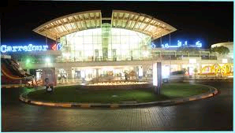
1. Who we are
We are the company that owns and runs Al Jimi Mall in Al Ain (ALDAR Properties, PJSC).
Treklense.com

Slide 5
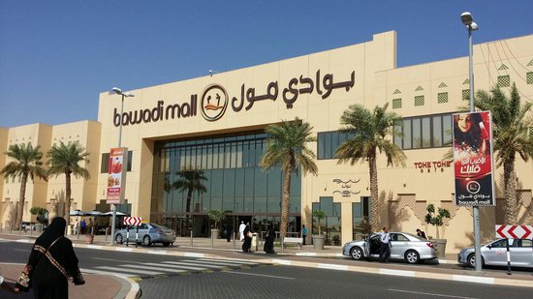
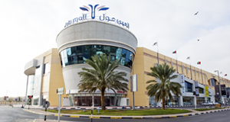
2. What our problem is
We have lost many of our customers to a larger mall (Bawadi Mall) and to the much improved Al Ain Mall. As a result, our profits have decreased.
Bawadi Mall Mall tripadvisor.co.uk
Al Ain Mall Mall alainmall.com

Slide 6

3. Focus Question
“How can we attract customers back to Al Jimi Mall and so increase our profits?”
clipartkids.com

Slide 7


Things to Consider: Sample Groups
Which sample groups will give you the most helpful information?
Single?
Split? e.g. adult mall shoppers - &
Split, symmetrical? – same questions
Split, asymmetrical? – different questions

Slide 8

Things to Consider: Survey Questions
Which question type will get the most useful answers?
Multiple Choice Questions
Likert Scale
Scaled Response
clipartkid.com

Slide 9
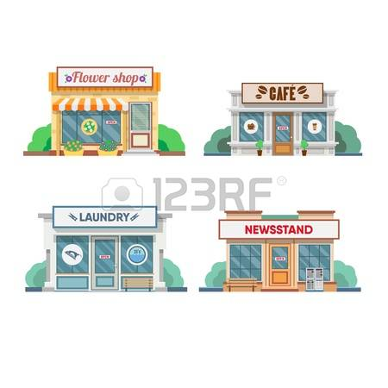


Things to Consider: Categories
Your survey could focus on
  Shops
  Restaurants
  Facilities
123rf.com
clipartfest.com
123rf.com

Slide 10


Example MC Question: Shops
  What type of shop do you want more of in Jimi Mall?
  Specialty food
  Toys
  Bookshops
  Other
  Don’t know

Slide 11

Example MC Question: Restaurants
What types of food would you like to find in the food court?
Lebanese
Turkish
Mexican
Chinese
Other
Don’t know
Always include these

Slide 12
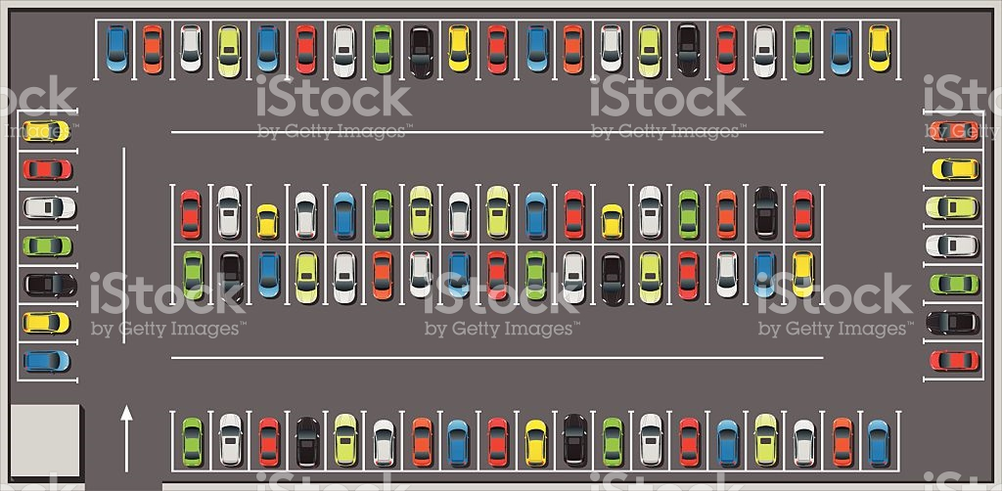
Example MC Question: Facilities
The type of parking you expect to use is:
Underground
Shaded/covered area
Unshaded
Valet
Other
Don’t know

Slide 13
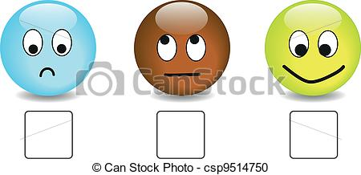
Example: Likert Scale
Al Jimi Mall needs to improve its parking facilities.
Statement, not a question.
Strongly Agree | Somewhat Agree | Neutral / No Opinion | Somewhat Disagree | Strongly Disagree

Slide 14
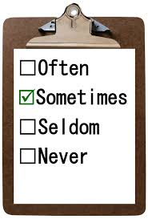
Example: Scaled Response
On average, how often do you go to Al Jimi Mall?
Used to help you understand people’s habits.
Every day | Once or twice a week | Once a month | Twice a year | Never
clipartlibrary.com

Slide 15
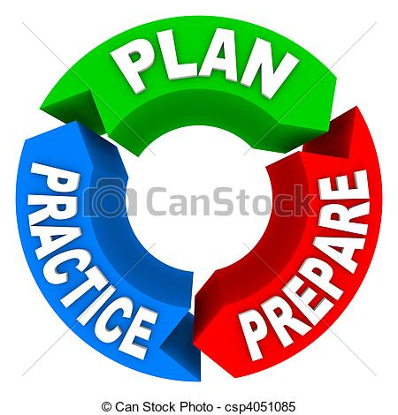
Practice
Now go to the handout for practice on making focus questions and survey questions.
Homework for the weekend:
Each student must write 4 survey questions about your company and bring them to the next class. This is part of the Midterm exam marks.
Next lesson:
Bring a laptop to type up your survey.

