Slide 1
Proposal Report
Introduction to Academic English
for
Business and Economics Students
Week 6, Lesson 2
www.uaeu.ac.ae

Slide 2
In this lesson you will:
1. Collate the survey data
Identify useful information
Create supporting graphs
Prepare a presentation about your data and proposals using PowerPoint
Homework:
Practice your toothpaste presentation ready to present next lesson
(UAEU, 2017)

Slide 3
Collating the Data
Carry out your survey
Type the data for each question onto the excel spreadsheet
R= researcher
Which is your favourite flavour of ice-cream? | Total | R1 | R2 | R3 | R4
vanilla | 45 | 20 | 14 | 8 | 3
chocolate | 28 | 1 | 6 | 9 | 12
strawberry | 6 | 0 | 2 | 3 | 1
mint chocolate chip | 15 | 3 | 3 | 4 | 5
other | 5 | 1 | 0 | 0 | 4
don't know | 1 | 0 | 0 | 1 | 0
Total N=100 | 100 | 25 | 25 | 25 | 25
N=the number of respondents

Slide 4
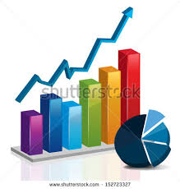
Using the Data
Look at all your team’s graphs.
Choose 4 to use for recommendations
Recommendations can be about any or all of the following:
Product development
Research
Advertising
Marketing
Remember: You must have the data to support your recommendations.

Slide 5
Using the Data (Cont.)
Identify:
Graphs that show trends
Possible recommendations
Graphs with no useful information - delete
Dalicetrost.com

Slide 6
Collating the Data: Making Graphs
3. Highlight the answers and the total column
Question - Which is your favourite flavour of ice-cream? | Total | R1 | R2 | R3 | R4
vanilla | 45 | 20 | 14 | 8 | 3
chocolate | 28 | 1 | 6 | 9 | 12
strawberry | 6 | 0 | 2 | 3 | 1
mint chocolate chip | 15 | 3 | 3 | 4 | 5
other | 5 | 1 | 0 | 0 | 4
don't know | 1 | 0 | 0 | 1 | 0
Total N=100 | 100 | 25 | 25 | 25 | 25

Slide 7
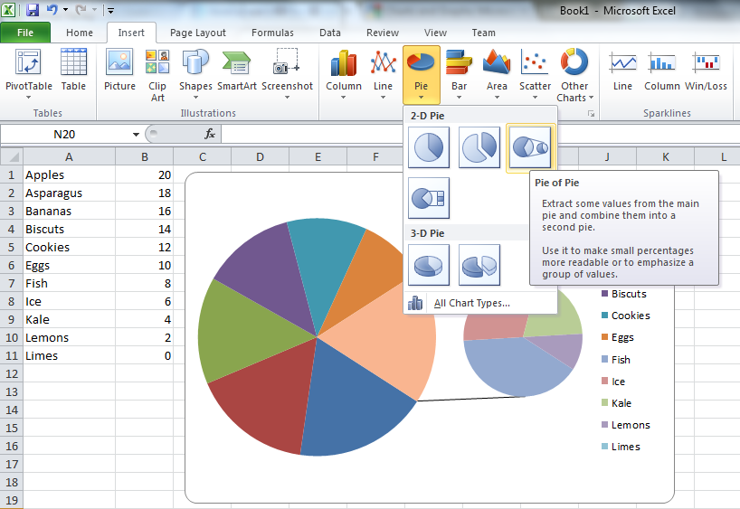
Collating the Data: Making Pie Charts
(superuser.com)

Slide 8
Collating the Data: Making Bar Graphs
www.qimacros.com

Slide 9
Example Pie Chart
Chart Title
Number of Respondents
Data
Categories
Speaker Details
Shaika Al Ketbi, 20179999, Section 599, 10.10.2017, Speaker C

Slide 10
Extra Information
For more information on making pie charts watch
https://www.youtube.com/watch?v=Ztz1gvLwPS8
For more information on making bar graphs watch
https://www.youtube.com/watch?v=dwaoJYSiTZ0
commons.wikimedia.com

Slide 11
Collating the Data: Over to You
Use the data from your toothpaste survey and:
complete the toothpaste collation excel spreadsheet
make graphs for each question
choose the most useful 4 graphs (use the focus question to help you)
create your graphs
practice your presentation (1 graph/person)

